Slide 1
JavaScript Fundamentals

Slide 2
Variables
It is a container.
Basically we grab a piece of memory and keep something in it for use later.
We create it, we name it and then we use it.
We can change it whenever we want.

Slide 3
Variables
var year;
var customerEmail;
var todaysDate;
var x;
Made up of letters, numbers, underscores and dollar signs.
Notes:
var is lower case. Not VAR.
The name should be representative of what it is.
Talk about case sensitivity.
Multiple variables. var year, month, day;
var year = 2018, month = 5, day =2;

Slide 4
Data Types
Describes type of data you intend.
Javascript is weakly typed.
Notes:
Show examples of how
myVariable = 200;
myVariable = “Hello”
myVariable = ‘hello’
myVariable = true;
myVariable = false;

Slide 5
Conditional JavaScript
if (condition) {
}
parentheseses mark our condition;
curly braces mark out what we need to do.
What is in the parentheses always comes down to true or false
Code block
Notes:
( parentheseses)
[ brackets ]
{ curly braces }
if(){}else{} and nesting these.

Slide 6
Operators and Expressions
Arithmetic operators
Assignment
Operator Precendence
result = 5 + 5 * 10
result = (5+5) * 10
Notes:
score = score + 10
score += 10
+= -= *= /=

Slide 7
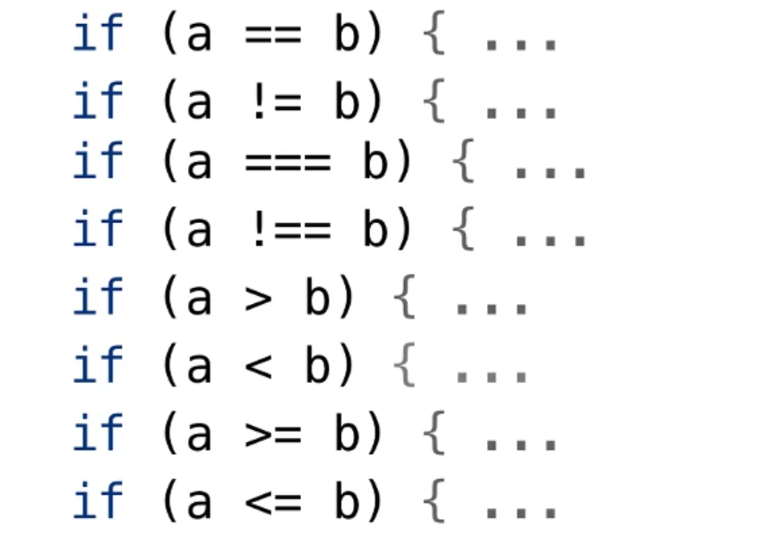
Equality and Comparison Operators
== equality
=== strict equality
Notes:
var a = 5;
var b= “5”
if(a ==b){
alert(“They are not equal”);
} else {
alert(“They are equal”);
}

Slide 8
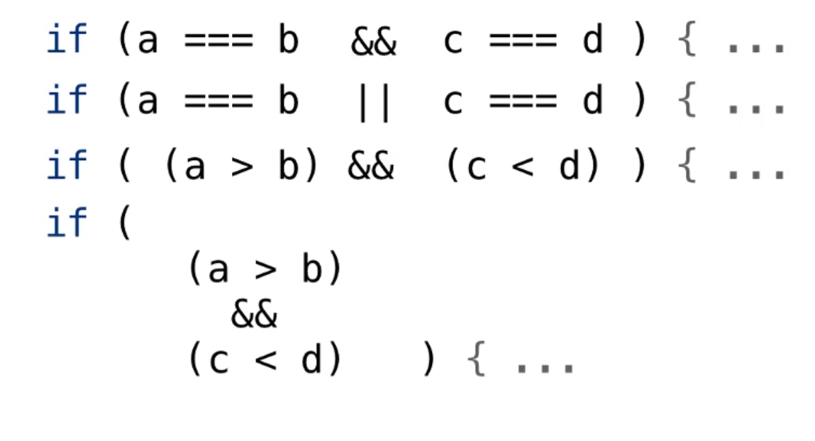
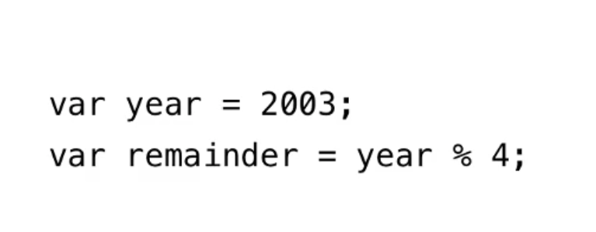
Logical And / Or

Slide 9
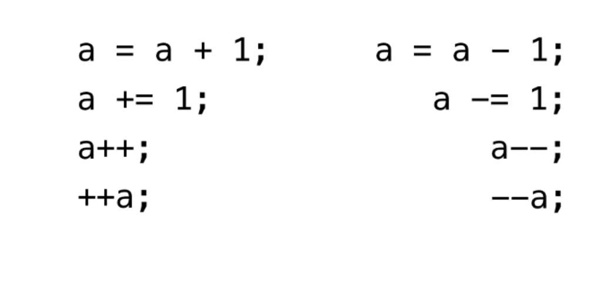
Increment and Decrement

Slide 10

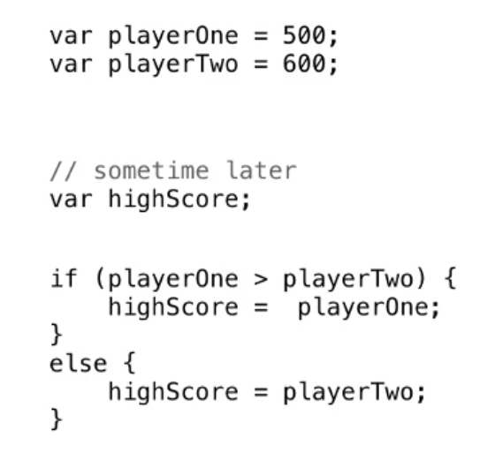
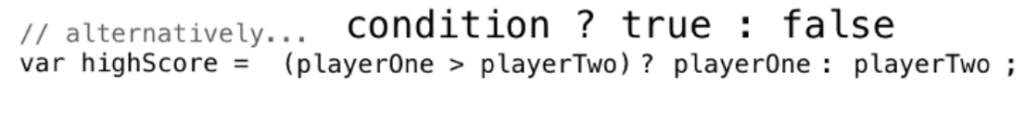
Ternary Operator

Slide 11
Loops
Do something until something happens.
The important part is when to stop.

Slide 12
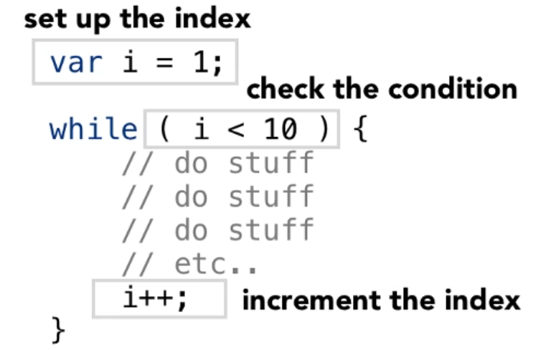
While Loop

Slide 13
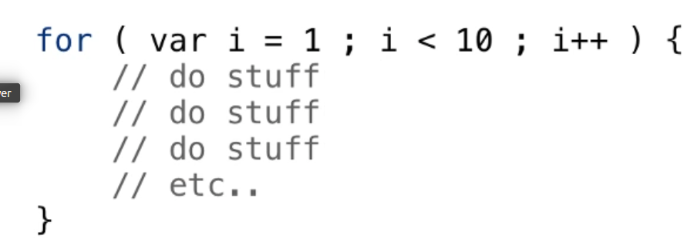
For Loop

Slide 14
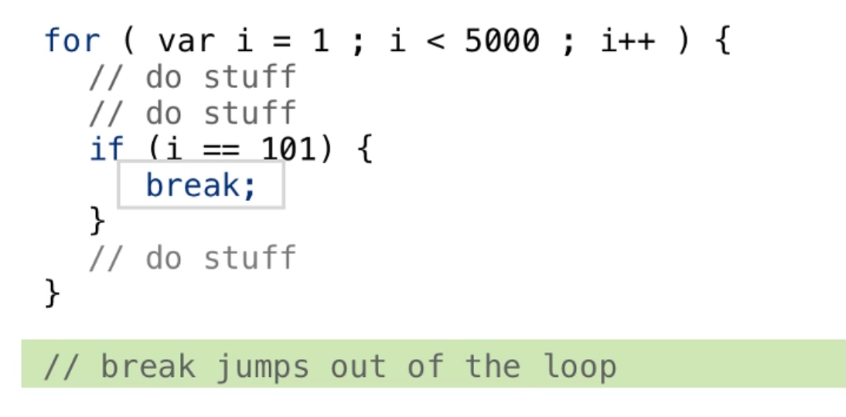
Break

Slide 15
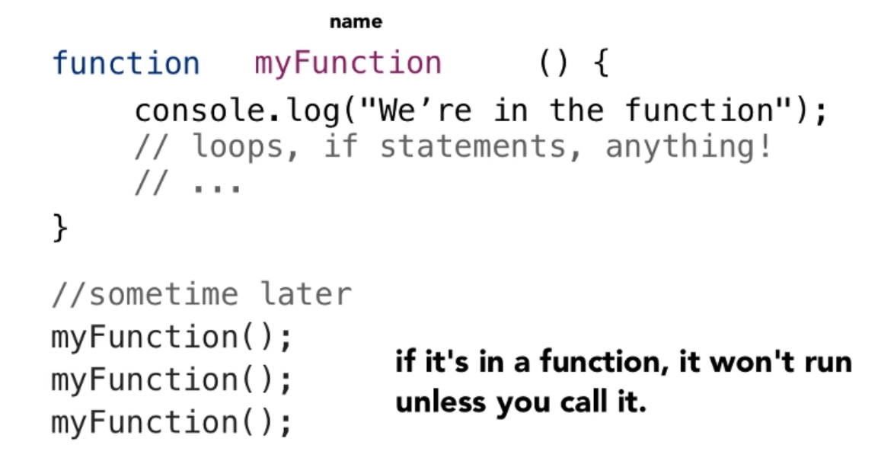
Functions
Notes:
Functions with Parameter
Returns

Slide 16
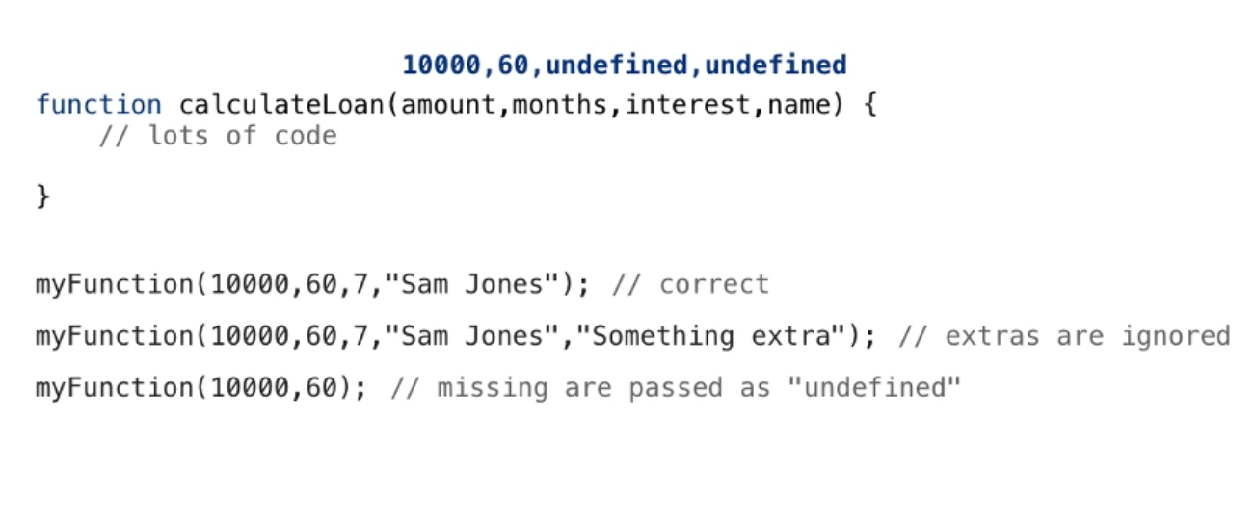
Parameter Mismatch

Slide 17
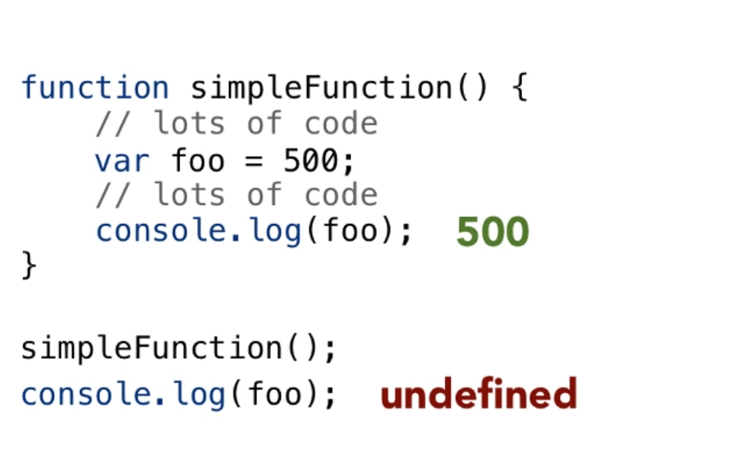
Variable Scope

Slide 18
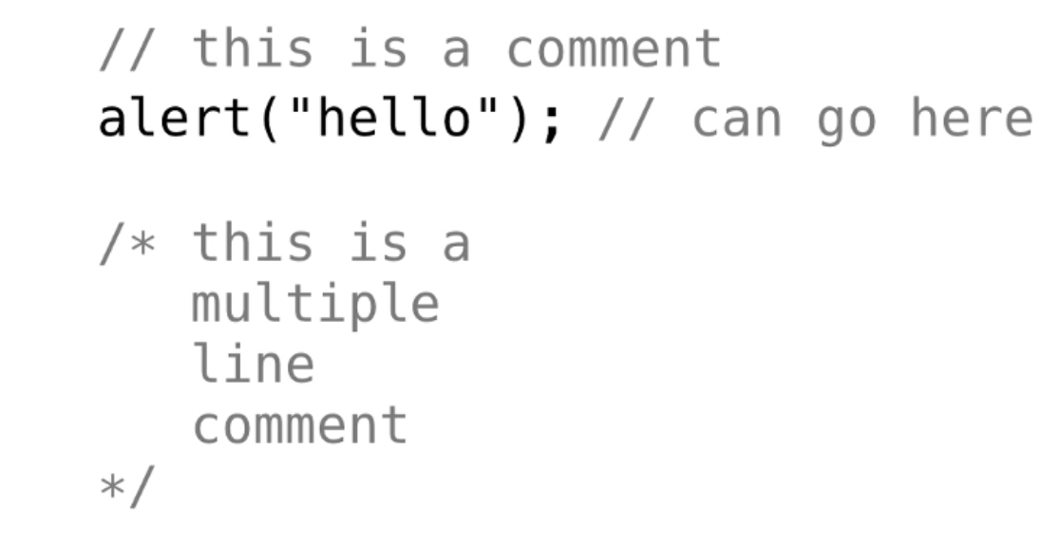
Comments

